Slide 1
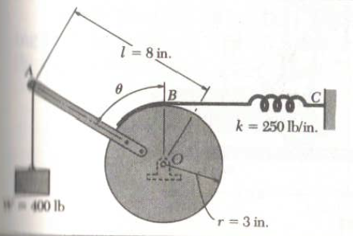
Equilibrium of Rotational Support Mechanism
Contributors:
Group 12
Kedar Hardikar – Student
Kedar Hardikar - Instructor

Slide 2

Rotational Support Mechanism Executive Summary
Last Updated: 11/18/23
Background
A support mechanism is desired for variable loading held in equilibrium at different configurations
Design proposed by the product team is to be analyzed for equilibrium loads
Problem Statement/Goal:
Validate proposed design through equilibrium calculations and provide an equilibrium configuration map of the equipment in various positions within specified range of equipment operation and supporting varying loads specified by the product team by Dec 22, 2023.
Stretch goal: Provide design map for changing length $l$ and spring constant k for various loads by January 2024.
Success Criteria:
Provide equilibrium equations describing member loads as a function of configuration angle $θ$ by Dec 22, 2023
Provide variation of load M with $θ$ graphically for ready use by the design team by Dec 22, 2023
Provide additional plots for the load variation to meet the stretch goal by Jan 2024.
  Strategy:
Phase 01: Analysis of static equilibrium using equations of rotational equilibrium. Establish member forces.
Phase 02: Validate the calculation for accuracy and consistency and generate required graphical representation
Phase 03: Examine variation of ‘l’ and M for the stretch goal
Key Milestones:
Identify design intent loads to be supported
Develop equilibrium equations
Check specific cases and review results for physical consistency.
Develop design guidelines
Identify methods to validate results experimentally
Deliverables & Commitments:
Identify design intent loads (Kedar – Instructor , 09/10/23)
Develop equilibrium equations (Kedar – Student, 09/14/23)
Check specific cases (team, partner, 10/01/23)
Consult and review ( team + instructor, 11/18/23 )
Issues / Risks and Mitigations:
Incorrect principles may have been used
  - Consult with ATPA coach and instructor.
Calculation errors may give incorrect results.
  - Identify limiting cases where the answer may be known from other methods to double check.
Sudden drop of load may imply significantly higher load on the mechanism
  Develop design safety factors using dynamic load factor.
  Key Updates/conclusions (11/18/23):
Analysis is successfully completed, validated and design guidelines provided
  - Consulted with ATPA coach and instructor.
Schedule Highlight: Owner: Start: Complete: Status:
Conceptualization Kedar- Instructor 09/10/23 09/11/23 Complete
Preliminary analysis Kedar- Student 10/12/23 10/15/23 Complete
Final analysis Kedar – Student 10/15/23 11/10/23 Complete
Review and Summary Kedar(Student) 11/18/23 TBD Ongoing

Slide 3
Your Project Title Executive Summary
Last Updated: xx/xx/xx
Background:
Necessary information to understand the problem statement
Problem Statement/Goal:
Crisp summary of the problem to be solved or a goal to achieve. This clarifies scope of the project – what is included and what is excluded.
Success Criteria:
Project closes when this is achieved.
Internal specs, cost targets, timeline etc.
Any customer driven specs.
Any other – e.g. retrofit capability
Strategy:
Define overall plan to execute the project and meet the success criteria. Define any project phases as needed
Phase 01: xxx
Phase 02: yyy
Key Milestones:
Specific outputs of project that meet success criteria ( Target xx/xx/xx)
Specific outputs in addition to (1) e.g. for future or lower priority requirements.
Deliverables & Commitments:
Define who/what/when (Target xx/yy/zz)
Define Specifications committed
Define tests or data committed
Define any hardware, service or other commercial items
Issues / Risks and Mitigations:
Risk Item 1
  - Mitigation.
Risk item 2.
  Mitigation
Key Updates/conclusions (xx/xx/xx):
Key points you need to land “today”
Schedule Highlight: Owner: Start: Complete: Status:
Conceptualization XYZ 4/4/23 xx/yy/zz Complete
Preliminary analysis PQR xx/yy/zz xx/yy/zz In progress

