Slide 1
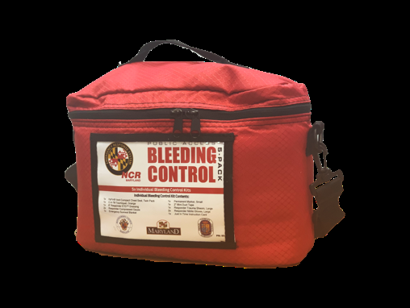
Public Access to Trauma Care: Familiarization Training for MC Students, Staff, and Faculty
Presented by the Office of Public Safety, Health, and Emergency Management

Slide 2
Tips and notes for using this presentation
Throughout the video portions of this presentation the term “Public Access to Trauma Control” will be used. The more common names for this product are “Bleeding Control kit” or “Stop the Bleed kits.”
Have your speakers turned on and the volume turned up.
Open the presentation to full screen for the best performance.
You must manually advance each slide.
When presented with a video, click on the arrow to play.
Click on the QR code at the end to take a satisfaction survey.
Questions? Email me at: michael.harting@montgomerycollege.edu
This course contains graphic images and videos that some may find disturbing.

Slide 3
Learning Objectives
The goal of this course is to familiarize students, staff, and faculty with the “requisite knowledge, skills, abilities, and equipment to treat life-threatening injuries.”
“These bleeding control kits are designed to allow civilians to treat life-threatening bleeding, penetrating trauma, hypothermia, and other life-threatening injuries prior to the arrival of medical professionals.”
This class should not take the place of a nationally recognized and certified class by one of several industry leaders in the area.
Maryland National Capitol Region Emergency Response System (2018)

Slide 4
Good Samaritan Law
An individual who provides medical aid will not be held civilly liable if they act in a reasonably prudent manner.
An individual who is not covered otherwise by this section is not civilly liable for any act or omission in providing assistance or medical aid to a victim at the scene of an emergency, if:
  (1) The assistance or aid is provided in a reasonably prudent manner;
  (2) The assistance or aid is provided without fee or other compensation; and
  (3) The individual relinquishes care of the victim when someone who is licensed or certified by this State to provide medical care or services becomes available to take responsibility.
MD Code, Courts, and Judicial Proceedings, § 5-603

Slide 5
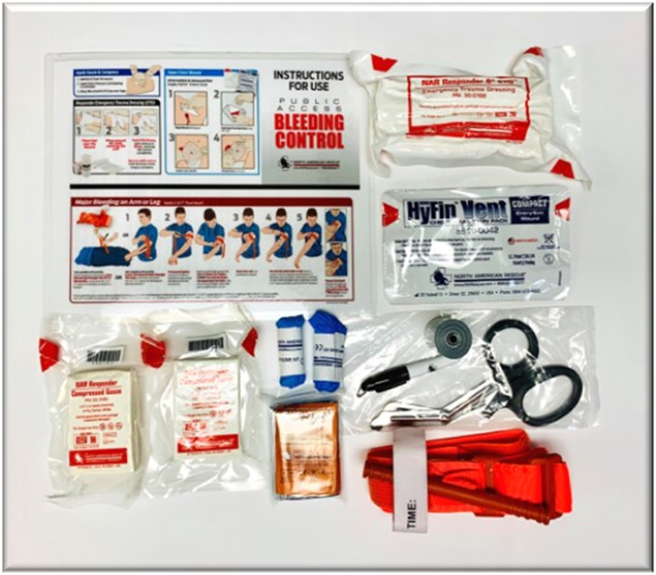
Bleeding Control kit locations and contents
There are several bleeding control kits in every building on campus. Each kit includes enough supplies to assist multiple patients suffering from a traumatic bleeding emergency. The kits are easily accessible and mounted on the wall in a white metal cabinet, located indoors in high-traffic, high-risk locations, near an AED.
In case of a serious bleeding emergency, send someone to retrieve a bleeding control kit.

Slide 6
Before you provide aid…
You need to ensure the scene is safe before you attempt to provide aid to anyone. Your safety should be your first concern. If the situation is unsafe, make it safe. If conditions change and the scene becomes unsafe, stop and move the victim to safety. Wear disposable gloves and eye protection if they are available. When the incident is over with…
  Wash your hands after treating any victim.
  Wash any clothes that come in contact with blood.

Slide 7
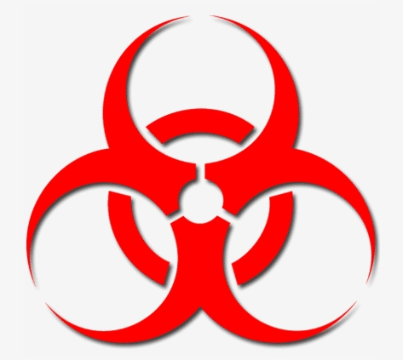
Bloodborne Pathogens Training
If you are a staff or faculty member of Montgomery College, you can sign-up for bloodborne pathogens training by following the steps in this link, here. Then search for “Bloodborne Pathogen Awareness.”

Slide 8
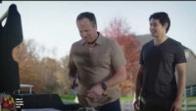
Why do you need this training?
You never know when you may need to provide life-saving first aid to a family member, friend, or loved one. Severe bleeding injuries can happen anywhere. At work, on vacation, or even at a picnic with friends.

Slide 9
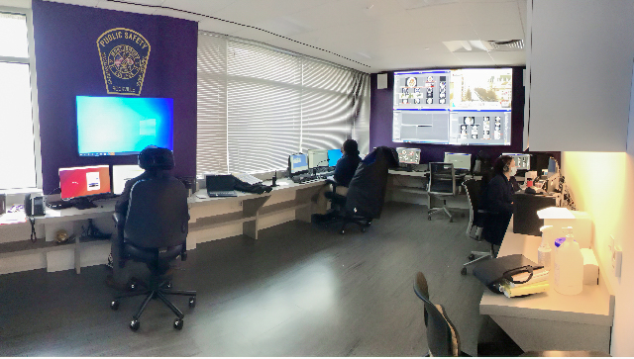
When you become aware of a life-threatening emergency, call 911
Call 911. Or, direct someone to call 911 to get trained medical officials to assist as soon as possible Be prepared to share:
  What happened?
  When and where it occurred?
  Your location.
  The number and status of the victim(s).
  Any ongoing threats to your safety.
  Never assume someone made the call! Make sure to follow all directions given by the 911 operator and don’t hang up until they tell you to do so. Then you or someone else should call MC Public Safety at 240-567-3333.

Slide 10
Provide aid if you are able
Things to look for…
Look for any bleeding. You are looking for continuous, large volume, or pooling of blood. Make sure you check under clothing, and if you are able and it is safe, turn the victim onto their side to check their back as well.
Attempt to control the bleeding by pressure (compress), packing, or by the use of a tourniquet.
Continuously re-assess the victim and provide further help if you are able.

Slide 11
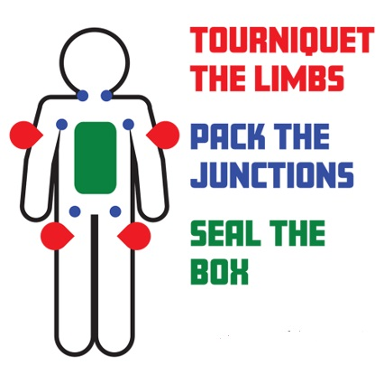
Care for the victim
There are five core skills in regard to bleeding control emergencies.
Those are:
1. Apply direct pressure
2. Pack a wound
3. Apply a tourniquet
4. Apply a chest seal
5. Treat for shock
Use tourniquets only on limbs (red areas).
Pack only areas in blue, underarms, and the joints between the legs.
Use a chest seal to green areas.

Slide 12
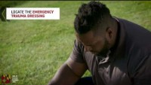
Apply Direct Pressure
Often times the simplest and easiest way to stop the flow of blood is to apply direct pressure with a compression bandage to the site of the wound. Watch this video to learn the proper technique for applying a compression bandage.

Slide 13
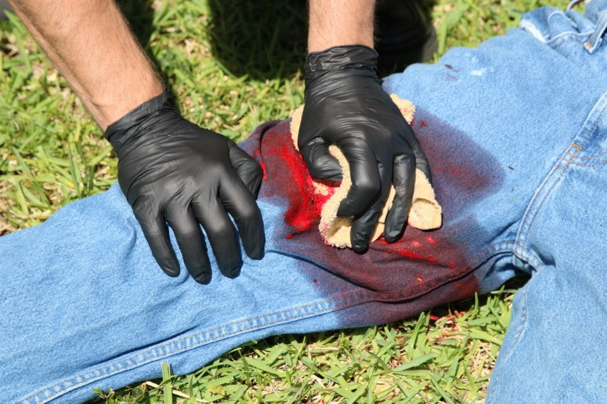
More about Applying Direct Pressure
In our race to use tourniquets for controlling hemorrhage, we often lose sight of the value of good direct pressure as a hemorrhage control technique.
crisis-medicine.com (2017)
*Use the 6” Emergency Trauma Dressing from the kit.

Slide 14
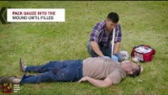
Pack a Wound
Generally, if a victim has a large gash that’s causing a lot of blood loss, you may need to pack the wound. Watch this video to learn the proper technique for packing a wound.

Slide 15
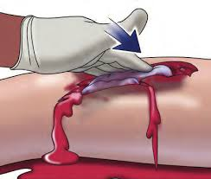
More about Packing a Wound
The U.S. military has been teaching wound packing with standard gauze and hemostatic dressings to its Corpsmen and Medics for years.
*Use the Compressed Gauze from the kit.

Slide 16
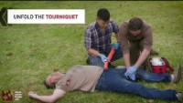
Apply a Torniquet
If the flow of blood is too heavy or there is too much trauma to the wound, you may need to apply a tourniquet. Watch this video to learn the proper technique for applying a tourniquet.

Slide 17
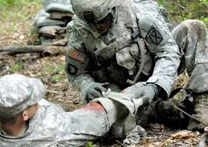
More about Tourniquets
When a tourniquet is properly applied, it hurts!
Once applied, do not loosen or remove.
*Make sure to use CAT-approved (Combat Action Tourniquet) tourniquets supplied in the Bleeding Control kits at MC.

Slide 18

Apply a Chest Seal
A chest seal is indicated when a patient has penetrating chest trauma anywhere between the neck to their navel, on the front, side, or back of the chest. It is important to understand that the chest seal doesn't control bleeding inside the chest cavity. Instead, the chest seal prevents air from entering the chest cavity. Watch this video to learn the proper technique for applying chest seals.
*Use the provided HyFin Chest Seal from the kit.

Slide 19
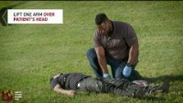
Treat for Shock
Shock is the body’s response to a sudden drop in blood pressure. It is a serious and deadly medical condition. Watch this video to learn the proper technique to treat shock.

Slide 20


Mobile Apps
MOBILE APPS
1. To download the Public Access to Trauma Care (PATC) app:
- Search for MD Public Access Trauma Care on Apple or Google Play Stores.
2. To download the Stop the Bleed app from the Uniformed Services University's National Center for Disaster Medicine and Public Health on your mobile device or tablet:
- Android: https://play.google.com/store/apps/details?id=edu.usuhs.stb
- iPhone: https://itunes.apple.com/us/app/stb/id1336173602?mt=8

Slide 21


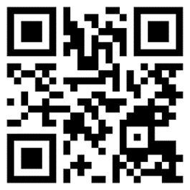
Questions?
Michael D. Harting
Emergency Management and Outreach Coordinator
Public Safety, Health, and Emergency Management
Michael.Harting@montgomerycollege.edu
www.montgomerycollege.edu/safety
(Please click on the QR code to take a short satisfaction survey).

